Slide 1
Dynamic Traffic Management System using Artificial Intelligence
Course Coordinator
Dr.Pratik Shah
Team Members
Hritik Mahajan Rohit Kumar Agrahari Sanskar Srivastava Sudhanshu kumar

Slide 2
Inspiration
Traffic congestion is becoming a serious problem with a large number of cars on the roads.
Traffic congestion not only add time and stress to drivers' lives, but they also increase fuel consumption and pollution.
Congestion in traffic can be caused by a variety of factors such as a lack of capacity, unregulated demand, long red light delays, and so on.
Traffic lights being one of the critical factors affecting traffic flow.

Slide 3
Conventional Systems
Manual Controlling : As the name suggests ,we require manpower to manage traffic.The traffic police sees road status and decides the allowed duration of each direction.
Automatic Controlling :Timers and electrical sensors operate the automatic traffic light. In the case of a traffic signal, the timer is set to a constant numerical number. Based on the timer value, the lights automatically turn on and off.
Electronic Sensors : Placing loop detectors or proximity sensors on the road is another advanced option. This sensor provides information about road traffic. Traffic signals are controlled based on this information.

Slide 4
Problem Statement
To develop a self-adaptive traffic light control system based on yolo. Due to disproportionate and diverse traffic in various lanes, inefficient usage of the same time slot for each of them results in slower speeds, longer trip durations, and more vehicle waiting.
Design a system that allows the traffic management system to make time allocation decisions for a given lane based on the traffic density on other lanes using cameras and image processing modules.
This method can override the earlier system of hardcoded lights, which causes unnecessary delays, lowering traffic and waiting time, reducing the frequency of accidents and fuel usage, and so helping to control air pollution.

Slide 5
Technology Used:-
1.YOLO
You only look once (YOLO) is a state-of-the-art, real-time object detection system YOLO, a new approach to object detection. Prior work on object detection repurposes classifiers to perform detection.
Instead, we frame object detection as a regression problem to spatially separated bounding boxes and associated class probabilities.
A single neural network predicts bounding boxes and class probabilities directly from full images in one evaluation. Since the whole detection pipeline is a single network, it can be optimized end-to-end directly on detection performance.

Slide 6
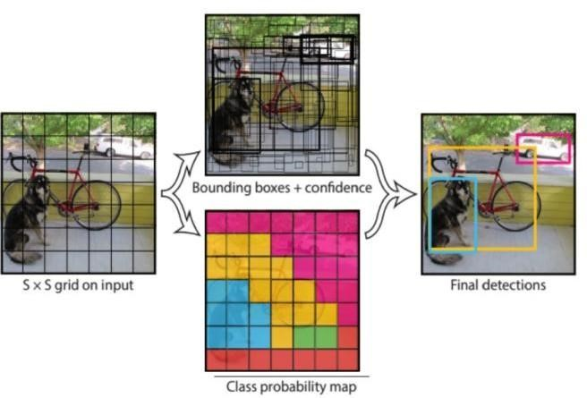
The object detection task consists in determining the location on the image where certain objects are present, as well as classifying those objects.
Previous methods for this, like R-CNN and its variations, used a pipeline to perform this task in multiple steps. This can be slow to run and also hard to optimize, because each individual component must be trained separately. YOLO, does it all with a single neural network

Slide 7
YoloV4 Car Counter
This is a project that counts automobiles in a video using the YoloV4 neural network. The detection happens every x frames, where x is a variable.The dlib library is also sometimes used to track previously recognised cars.
Furthermore, you can edit confidence detection level, number of frames to count vehicle as detected before removing it from trackable list and the maximum distance from centroid (see Centroid Tracker class), number of frames to skip detection (and only use tracking) and the whether to use the original video size as annotations output or the YoloV4 256x256 size.

Slide 8
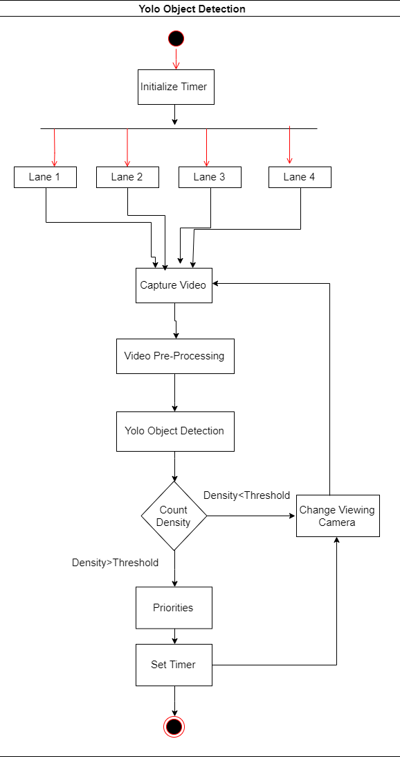
Flow Chart
1.Get a real time image from the traffic catching camera
2.Scan and determine the traffic density
3.Input this data to the Time Allocation module
4.The output will be the time slots for each lane accordingly.

